Slide 1
Configure a Wireless Router
LAN Switching and Wireless – Chapter 7

Slide 2
Objectives
Describe the components and operations of basic wireless LAN topologies.
Describe the components and operations of basic wireless LAN security.
Configure and verify basic wireless LAN access.
Configure and troubleshoot wireless client access.

Slide 3
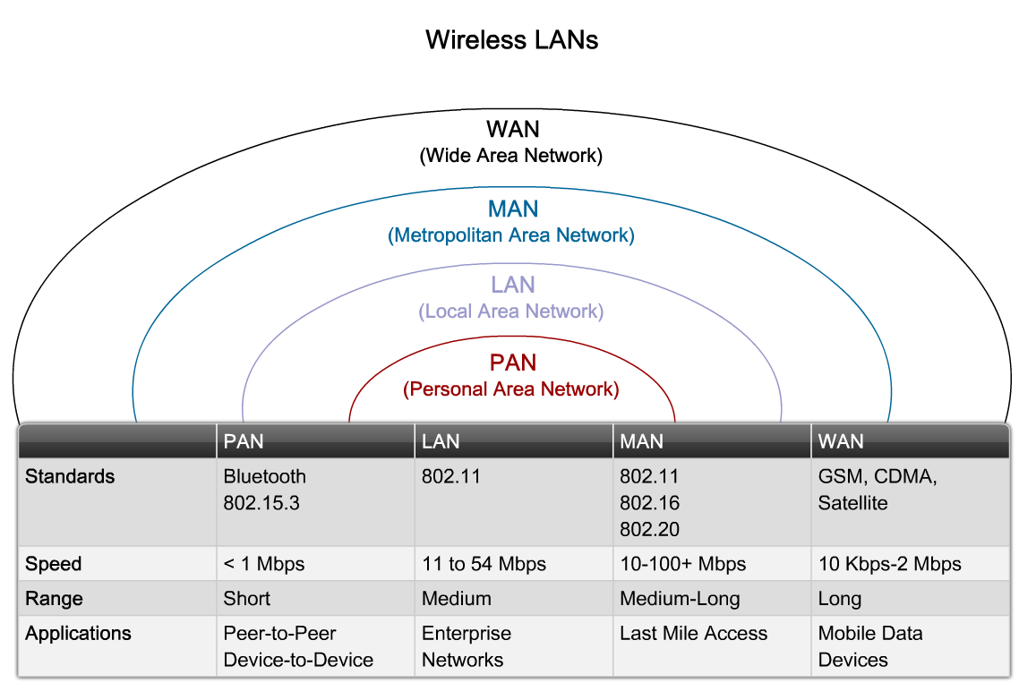
Explain the Components and Operations of Basic Wireless LAN Topologies
Describe why wireless LANs are a popular choice for small business LAN implementations

Slide 4
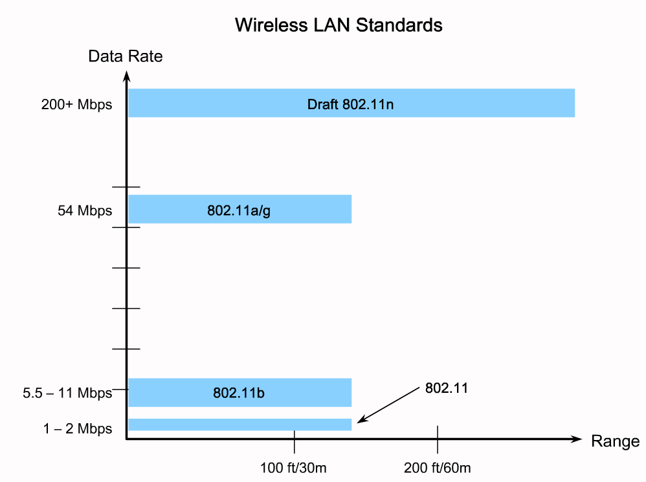
Explain the Components and Operations of Basic Wireless LAN Topologies
Describe the 802.11 wireless standards

Slide 5
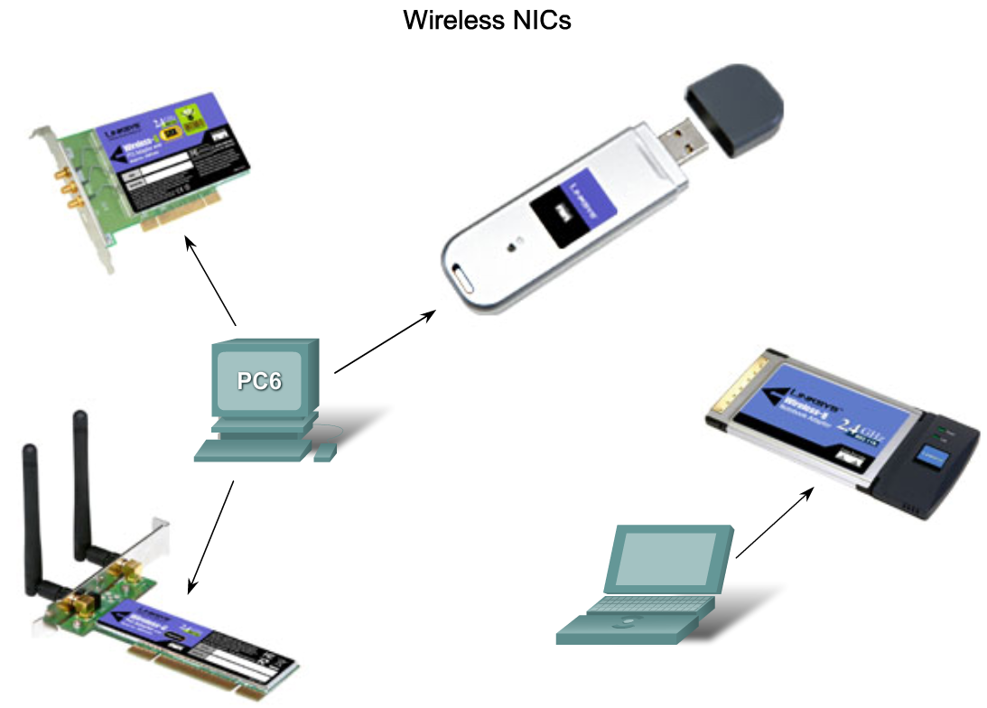
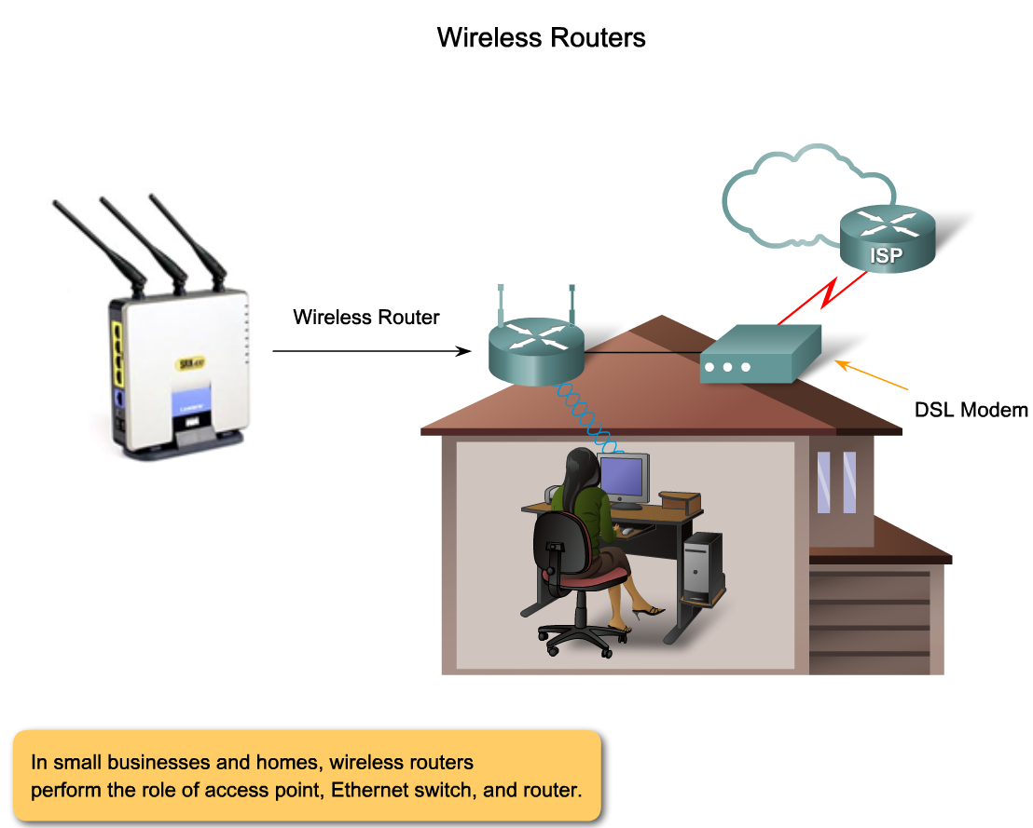
Explain the Components and Operations of Basic Wireless LAN Topologies
Describe the components of a 802.11-based wireless infrastructure

Slide 6
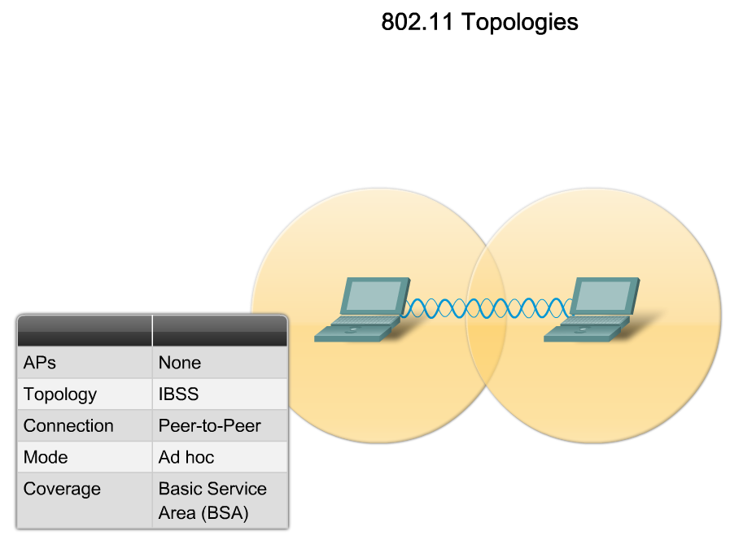
Explain the Components and Operations of Basic Wireless LAN Topologies
Describe how wireless networks operate

Slide 7
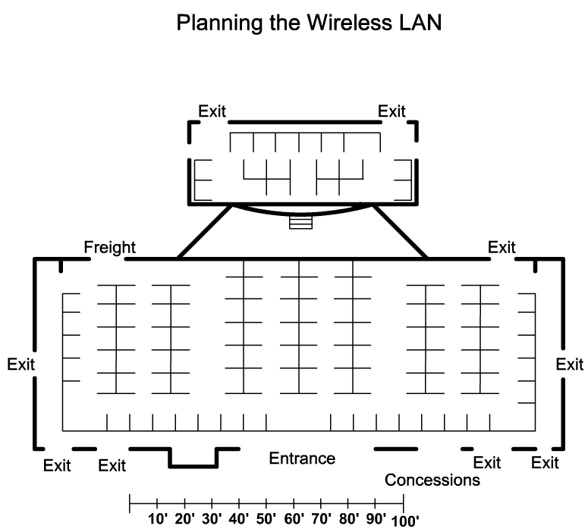
Explain the Components and Operations of Basic Wireless LAN Topologies
Describe how to plan a wireless LAN

Slide 8
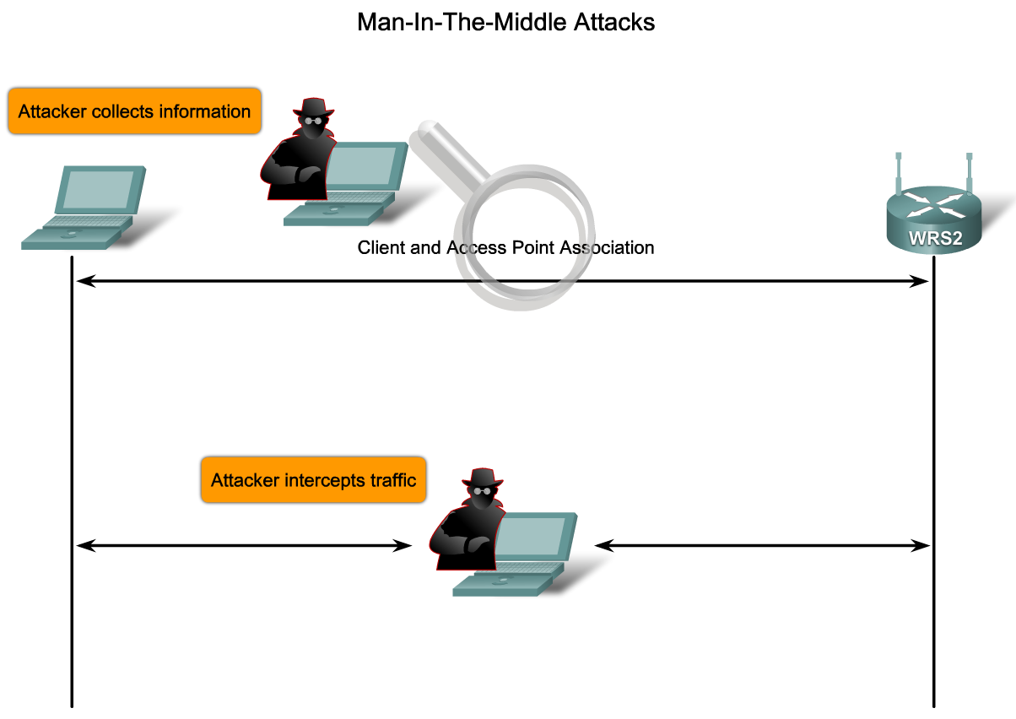
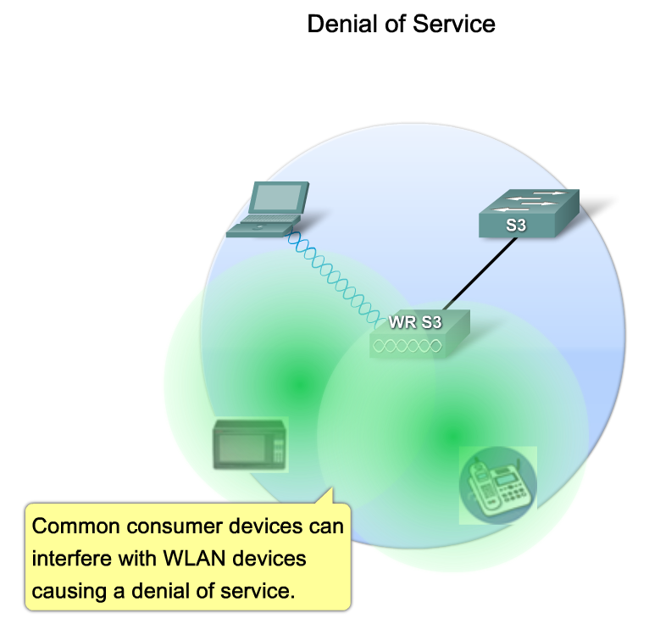
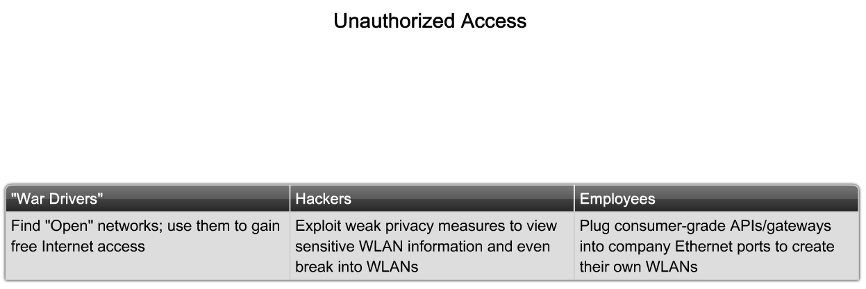
Explain the Components and Operations of Basic Wireless LAN Security
Describe the threats to wireless LAN security

Slide 9
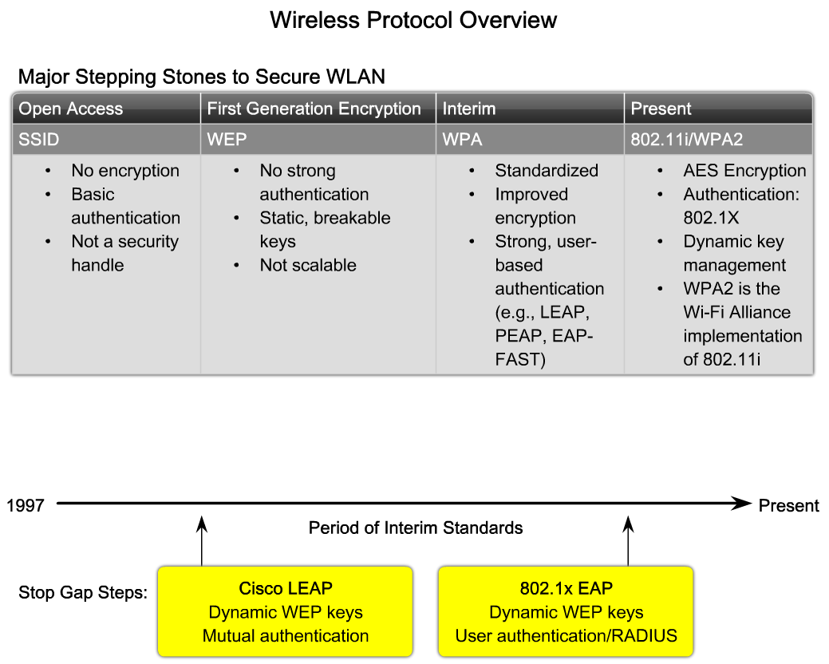
Explain the Components and Operations of Basic Wireless LAN Security
Describe the wireless protocols. The description will include a description of 802.1x, a comparison of WPA and WPA2 as well as comparison of TKIP and AES

Slide 10
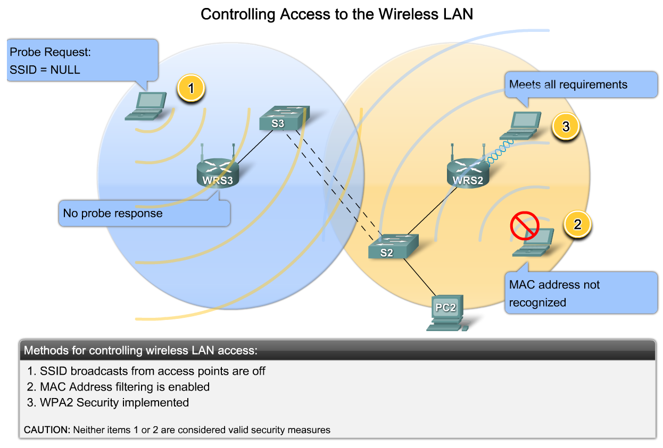
Explain the Components and Operations of Basic Wireless LAN Security
Describe how to secure a wireless LAN from the key security threats

Slide 11
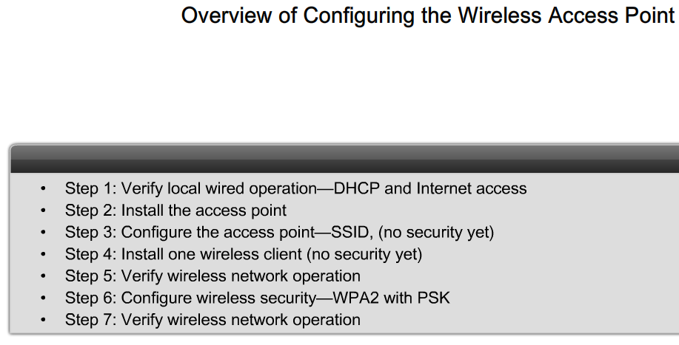
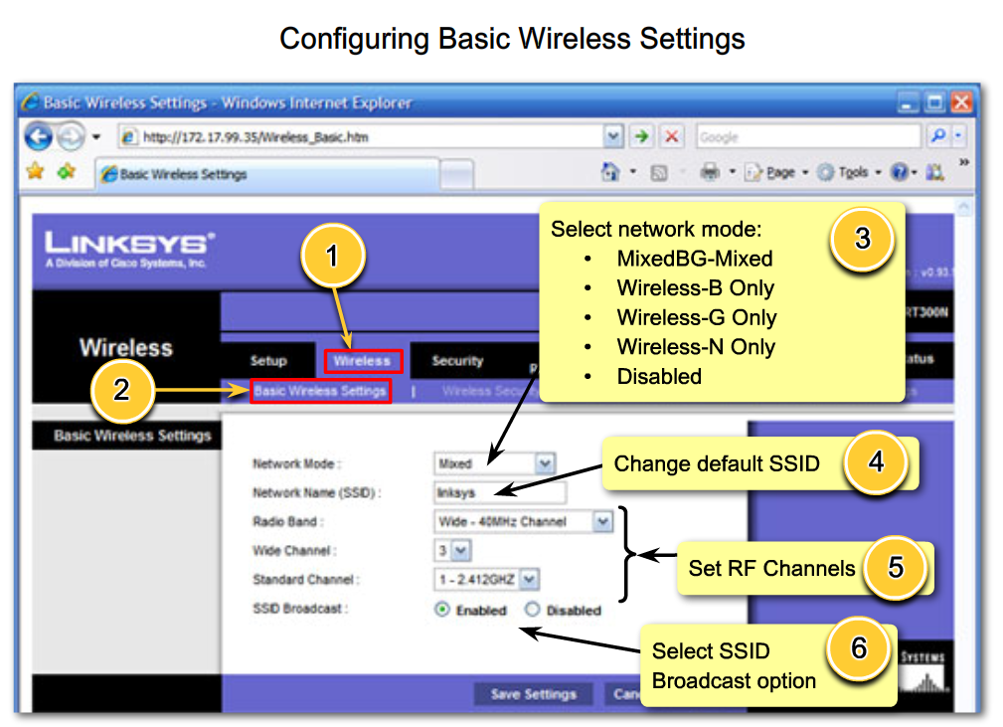
Configure and Verify Basic Wireless LAN Access
Configure a wireless access point

Slide 12
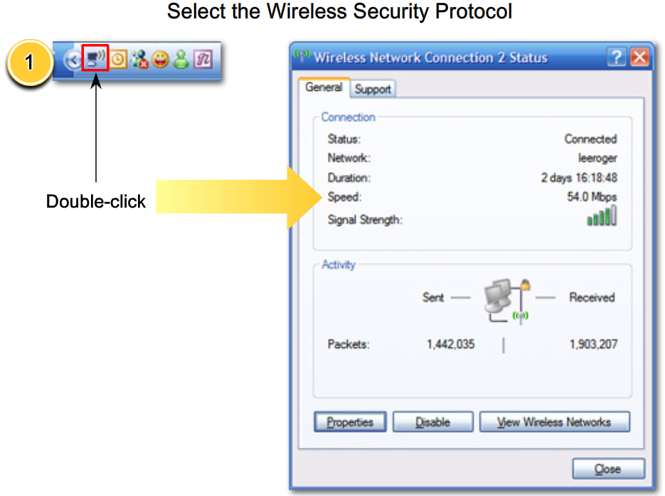
Configure and Verify Basic Wireless LAN Access
Configure a wireless NIC

Slide 13
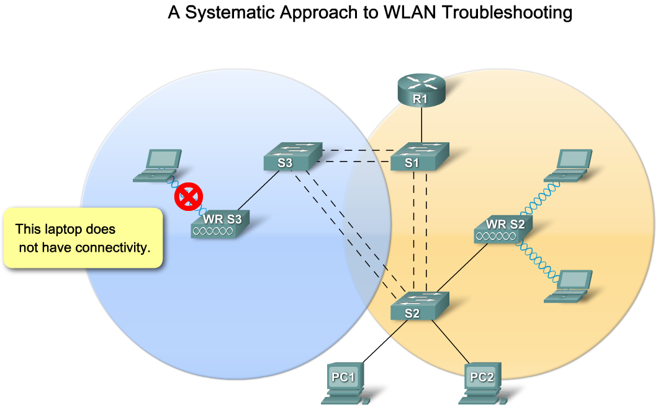
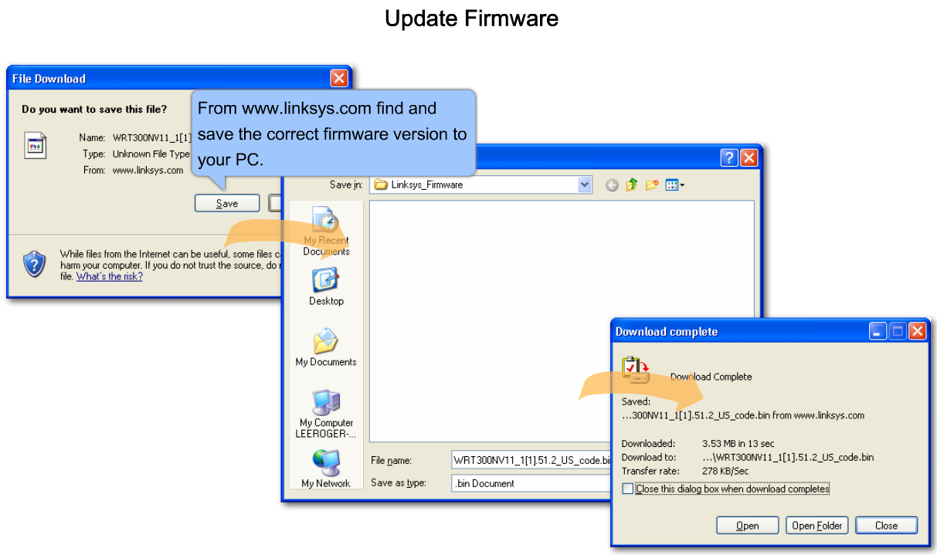
Configure and Troubleshoot Wireless Client Access
Describe how to solve access point firmware issues

Slide 14
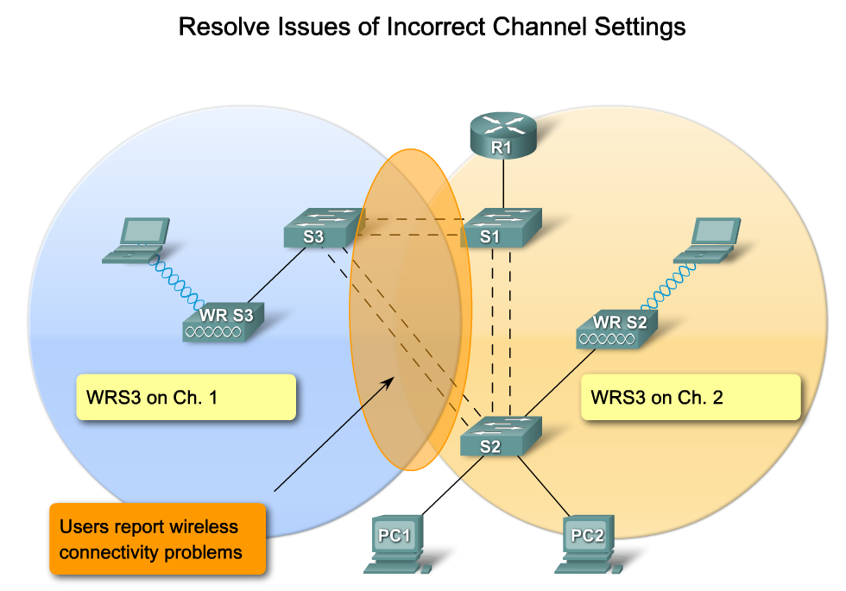
Configure and Troubleshoot Wireless Client Access
Describe how to solve incorrect channel settings

Slide 15
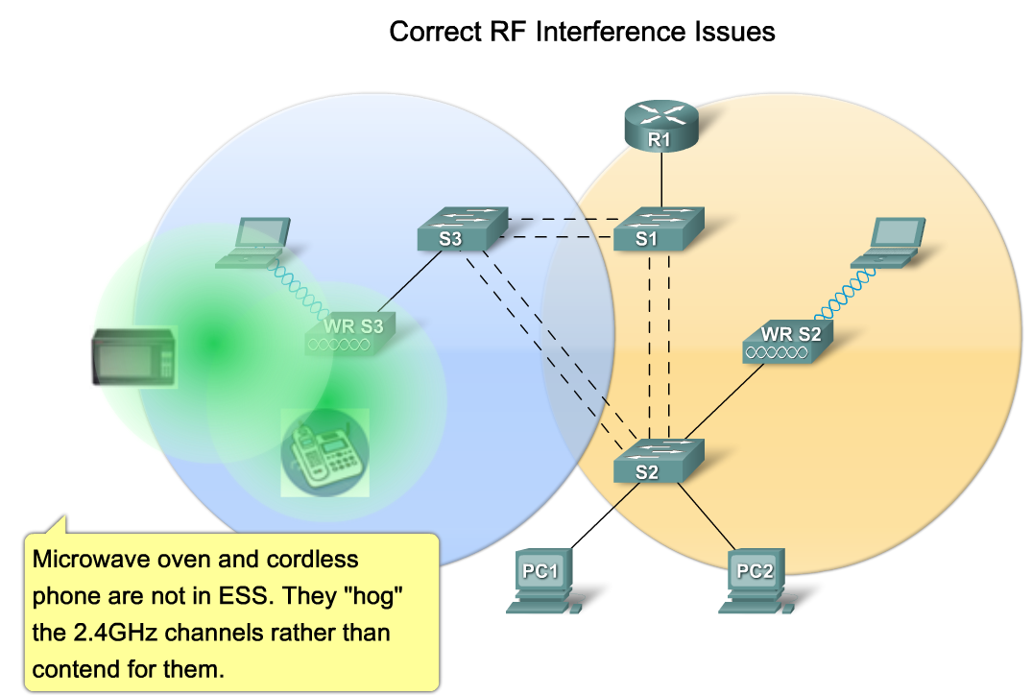
Configure and Troubleshoot Wireless Client Access
Describe how to solve common RF interference issues

Slide 16
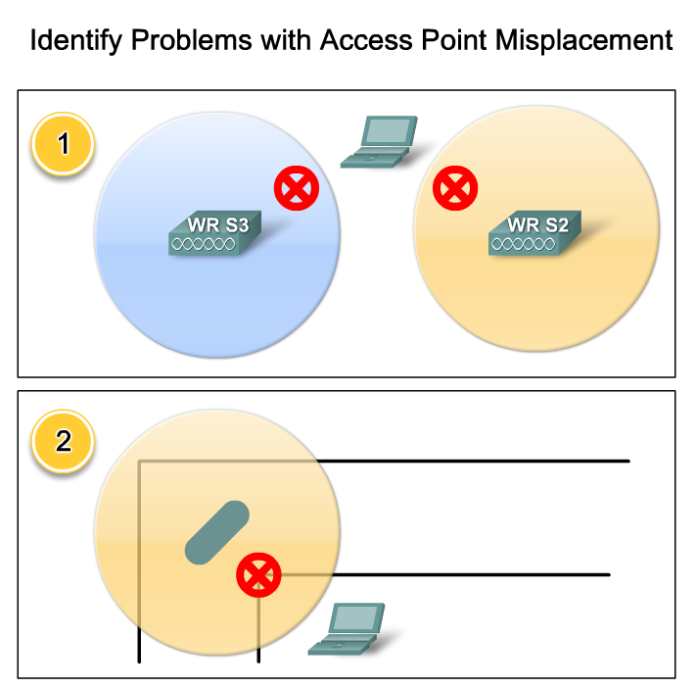
Configure and Troubleshoot Wireless Client Access
Describe how to correct antenna misplacement

Slide 17
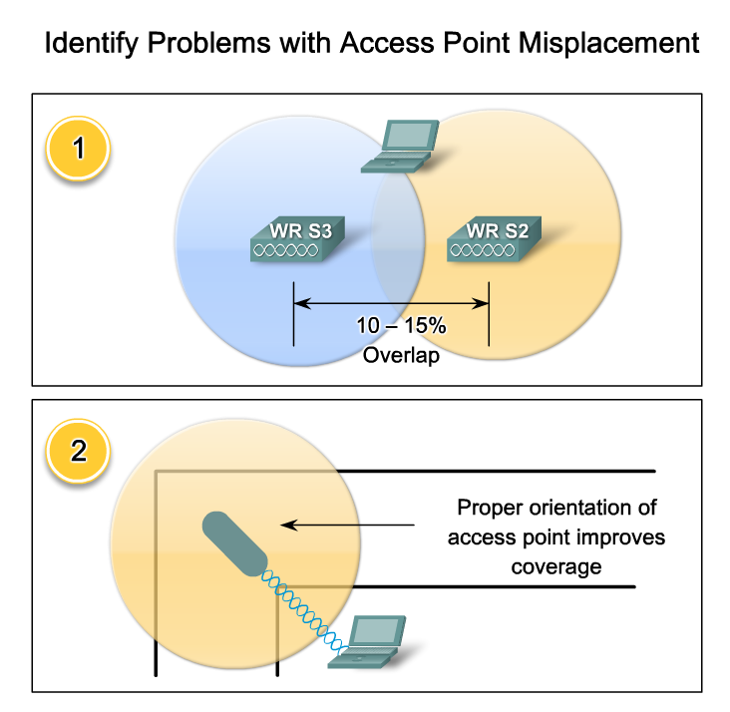
Configure and Troubleshoot Wireless Client Access
Describe how to solve the common problems associated with wireless LAN encryption types

Slide 18
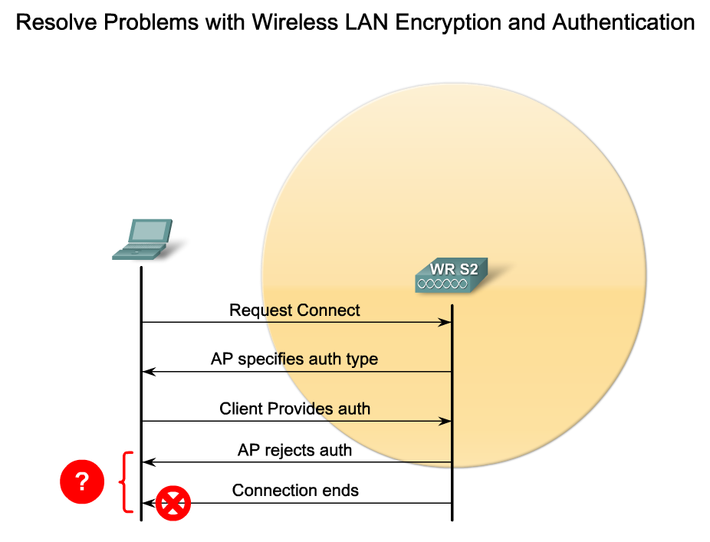
Configure and Troubleshoot Wireless Client Access
Describe how to solve authentication problems associated with wireless LANs

Slide 19
Summary
Wireless LANs use standards such as
  IEEE 802.11a
  IEEE 802.11b
  IEEE 802.11g
  IEEE 802.11n
Basic Service set
  Mobile clients use a single access point for connectivity
Extended service set
  Multiple access point that share an SSID

Slide 20
Summary
WLAN security practices/methods include
  MAC address filtering
  SSID making
  Implementing WPA2
Configuration of wireless NIC and access point
  Configure both of them the same way
    SSID
  Ensure that the latest firmware is installed
Troubleshooting WLANs include doing the following:
  Check channel setting
  Check for interference

